Slide 1
TOPIC MODELING COMPARISON CASE : NIPS PAPER DATASET
M. DJAMALUDDIN
33218027
Github REPO : https://github.com/mdja/topic_model

Slide 2
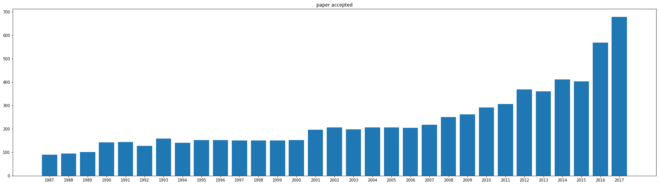
NIPS PAPER DATASET
NIPS : Neural Information Processing Systems, top machine learning conference. https://nips.cc/
Dataset : https://www.kaggle.com/benhamner/nips-papers, data paper available from 1987 – 2017

Slide 3
TOPIC MODELING
Statistical modeling for discovering the abstract “topics” that occur in a collection of documents
Methods :
LSA (Latent Semantic Analysis)
PLSA (Probability Latent Semantic Analysis)
NMF (non Negative Matrix Factorization)
LDA (Latent Dirichlet Allocation)

Slide 4
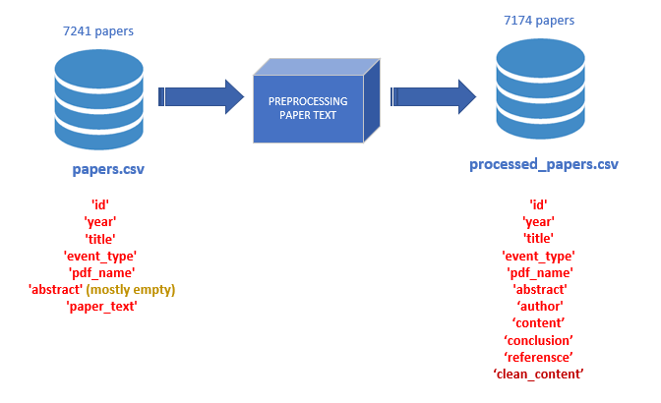
DATASET PREPROCESSING
Pre-processing :
Split paper_text into (abstract, author, content, conclusion, reference)
Use: Regex pattern,
- (1|1.)*\s*INTRODUCTION
- \w*(1.)*[A|AN|THE]*\s[A-Z]{2}\w*[A-Z]\w*
- '[\\n]+(1|1.)[\\n]+
+ Eliminate stop words
+ remove digits
+ remove len(words) < 3
+ replace(‘\n’,’ ‘)
+ lower case
+ Lemmatization

Slide 5
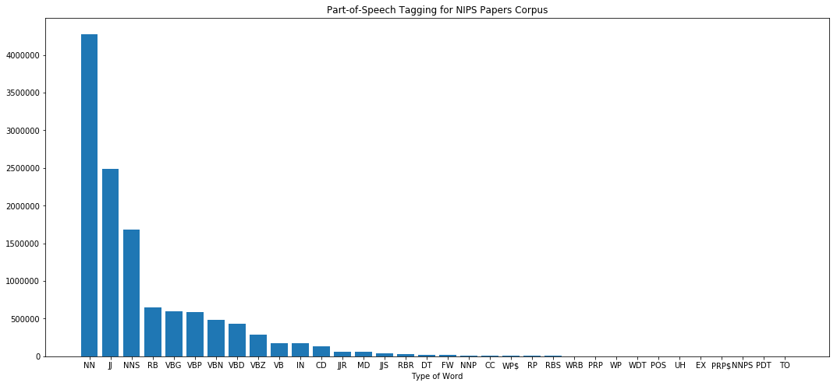
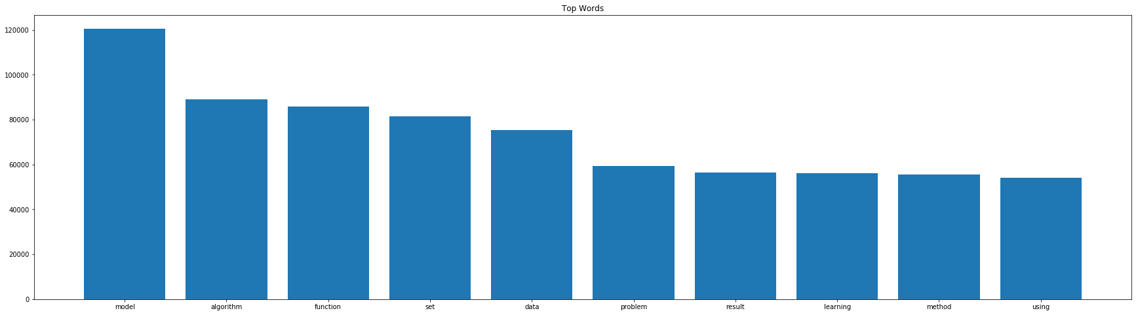
POS Tag in NIPS paper
10 Top Word Used

Slide 6
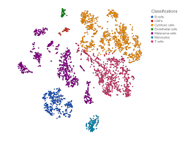
T-SNE (T-DISTRIBUTED STOCHASTIC NEIGBOURING ENTITIES)
sklearn.manifold.TSNE
T-SNE : technique for dimensionality reduction and is particularly well suited for the visualization of high-dimensional datasets
“t-Distributed stochastic neighbor embedding (t-SNE) minimizes the divergence between two distributions: a distribution that measures pairwise similarities of the input objects and a distribution that measures pairwise similarities of the corresponding low-dimensional points in the embedding” (Van der Maaten, 2008)
High dimensional matrix
Plot 2-D by keeping
the similarity vector

Slide 7
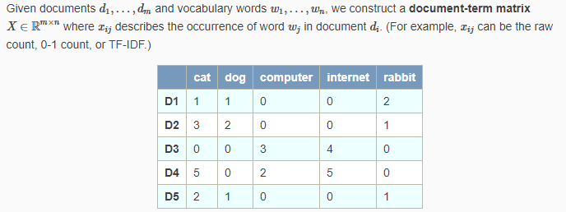

TOPIC MODELING
LSA
The latent in Latent Semantic Analysis (LSA) means latent topics. LSA finds low-dimension representation of documents and words.
Decompose Matrix X into 3 component using SVD
sklearn.decomposition.TruncatedSVD

Slide 8
LSA : Found 34 topics
Topic 0: model algorithm function
Topic 1: neuron network cell
Topic 2: policy reward action
Topic 3: spike neuron firing
Topic 4: spike stimulus model
Topic 5: kernel image face
Topic 6: node graph edge
Topic 7: kernel graph vertex
Topic 8: kernel tree node
Topic 9: blur image blurring
Topic 10: arm regret bandit
Topic 11: cluster clustering algorithm
Topic 12: topic document word
Topic 13: tree node petition
Topic 14: cell stimulus response
Topic 15: tree suffix string
Topic 16: game player equilibrium
Topic 17: circuit chip voltage
Topic 18: adaboost margin ascent
Topic 19: manifold isomap data
Topic 20: agent reward arm
Topic 21: object feature ibp
Topic 22: agent representation grid
Topic 23: tensor spike rank
Topic 24: cell rat firing
Topic 25: tensor decomposition matrix
Topic 26: tensor compartment geodesic
Topic 27: query label answer
Topic 28: item user rating
Topic 29: motion velocity direction
Topic 30: submodular function submodularity
Topic 31: estimator mse kernel
Topic 32: classifier message rbf
Topic 33: worker manifold expert
Topic 34: bam memory associative
Topic 0: model algorithm function data network set matrix image distribution learning method problem training feature kernel error result bound using parameter time sample number point vector log input probability value figure
Topic 1: neuron network cell spike stimulus input synaptic response activity model layer firing pattern circuit unit connection synapsis visual excitatory figure output inhibitory frequency chip neural time signal cortical fig inhibition
Topic 2: policy reward action agent state mdp function algorithm value regret learning optimal trajectory time transition problem model environment reinforcement bound mdps probability expert set step planning episode decision exploration distribution
Topic 3: spike neuron firing synaptic postsynaptic spiking stdp presynaptic rate membrane input time synapsis synapse train potential weight network model signal function rule learning circuit timing voltage poisson dynamic dendritic threshold
Topic 4: spike stimulus model neuron distribution poisson population correlation response filter renewal gqm glm data count copula cascaded fig plds synchrony recording bin fit train spiking cell time word ising parameter
Topic 5: kernel image face feature shape descriptor inn space signal facial cpd database recipe suppressive pca recognition spike subspace grassmann svm linear eigenface svms function similarity basis universal definite pixel stimulus
….

Slide 9
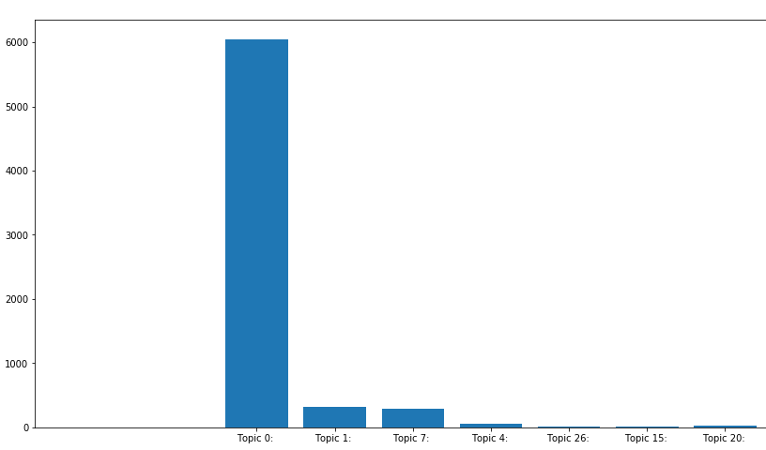
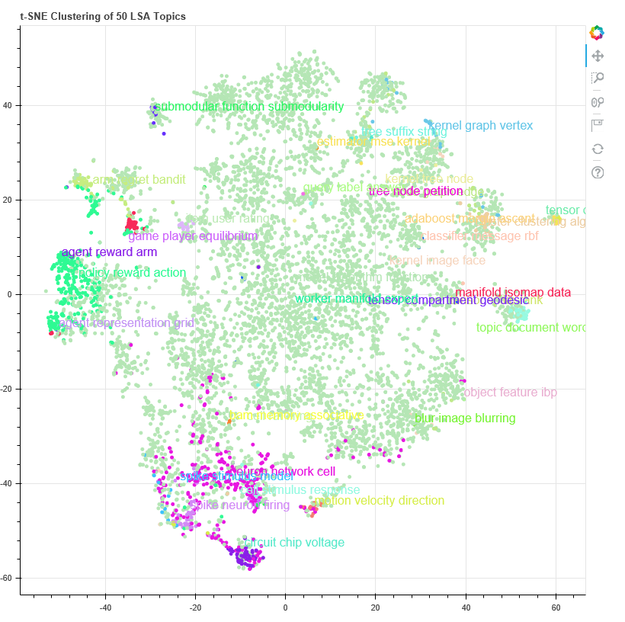

Slide 10
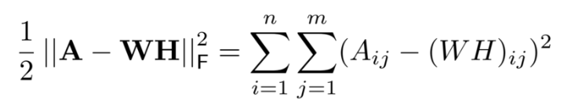
NMF
Factors high-dimensional vectors into a low-dimensionality representation. Similar to Principal component analysis (PCA), NMF takes advantage of the fact that the vectors are non-negative. By factoring them into the lower-dimensional form, NMF forces the coefficients to also be non-negative.
Given A = Document Matrix, Find W, H such that A = WH. Where
W = Basic Vector – topic discovered from documents
H = Coefficient Matrix – membership weight for topics in each doc
Obejctive Function :
sklearn.decomposition.NMF

Slide 11
NMF : Found 50 topics
Topic 0: lasso group screening
Topic 1: neuron network synaptic
Topic 2: policy action state
Topic 3: image model pixel
Topic 4: network neural input
Topic 5: model data parameter
Topic 6: regret bound algorithm
Topic 7: graph vertex edge
Topic 8: classifier adaboost training
Topic 9: kernel function data
Topic 10: topic document lda
Topic 11: stimulus response neuron
Topic 12: cluster clustering algorithm
Topic 13: player game equilibrium
Topic 14: function basis polynomial
Topic 15: circuit chip voltage
Topic 16: bound log theorem
Topic 17: tree node leaf
Topic 18: layer network dropout
Topic 19: state transition model
Topic 20: word sentence model
Topic 21: label unlabeled algorithm
Topic 22: tensor rank matrix
Topic 23: agent action policy
…
Topic 47: reward action policy
Topic 48: expert network gating
Topic 49: unit network hidden
Topic 0: lasso group screening problem solution norm sparsity sparse regression convex set penalty matrix condition min regularization model algorithm variable support method dual theorem function selection vector recovery let result max
Topic 1: neuron network synaptic firing input model spike activity dynamic pattern connection synapsis neural excitatory time spiking inhibitory stimulus function learning membrane state response fig weight system potential conductance figure rate
Topic 2: policy action state reward mdp function algorithm value optimal agent transition gradient problem mdps learning model trajectory iteration distribution bound bellman time cost probability set method planning step controller using
Topic 3: image model pixel patch feature face object training network set color data layer using shape scene result method filter figure segmentation texture visual region algorithm distribution pose representation used one
Topic 4: network neural input training neuron output function weight model layer pattern unit time learning set state system dynamic one memory recurrent data architecture wa error number hidden figure attractor result
Topic 5: model data parameter distribution causal set prediction function training mixture log variable algorithm network learning sequence one latent using probability gaussian number likelihood two method time result matrix figure prior
Topic 6: regret bound algorithm action loss round online bandit log convex learner function lemma theorem problem let setting set strategy sequence proof time arm minimax adversary reward distribution expert learning policy
…

Slide 12
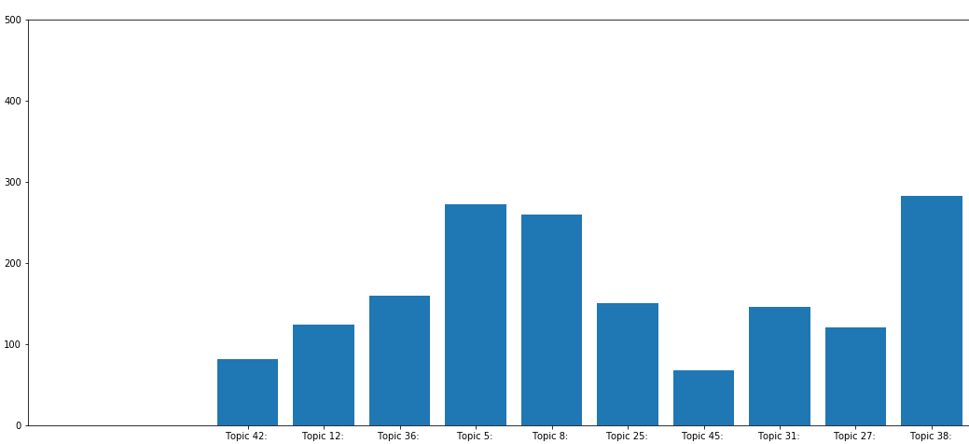
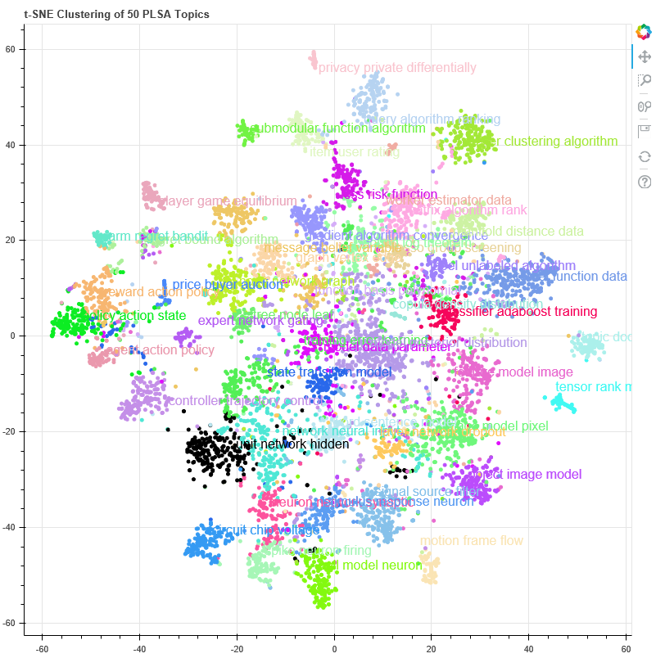

Slide 13
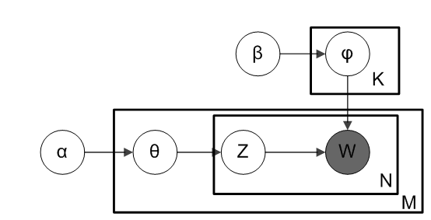
LDA
LDA is an unsupervised learning methods that views documents as bags of words. LDA works by first making a key assumption: the way a document was generated was by picking a set of topics and then for each topic picking a set of words.
From plate diagram of an LDA model : α is the per-document topic distributions, β is the per-topic word distribution, θ is the topic distribution for document m, φ is the word distribution for topic k, z is the topic for the n-th word in document m, and w is the specific word
sklearn.decomposition.LatentDirichletAllocation

Slide 14
LDA : Found 39 topics
Topic 0: data user time
Topic 1: policy state function
Topic 2: reward algorithm action
Topic 3: layer network model
Topic 4: data time algorithm
Topic 5: model stimulus response
Topic 6: graph edge algorithm
Topic 7: node tree algorithm
Topic 8: algorithm problem function
Topic 9: model learning data
Topic 10: network function model
Topic 11: function algorithm set
Topic 12: state model time
Topic 13: data algorithm point
Topic 14: gene model expression
Topic 15: neuron model spike
Topic 16: algorithm bound regret
Topic 17: motion model direction
Topic 18: point algorithm set
…
Topic 38: model word set
Topic 39: time model spike
Topic 0: data user time packet algorithm policy number privacy set rate value network problem node state result load private learning mechanism classifier given ha traffic method size figure sample vector function
Topic 1: policy state function action value algorithm reward agent learning model problem time set optimal using result number probability method space distribution ha step given figure transition task parameter use approach
Topic 2: reward algorithm action regret arm bandit model time problem bound learning probability case set expected distribution context setting number exploration policy optimal ha result value log figure parameter decision state
Topic 3: layer network model learning training weight unit parameter input using set hidden number data result error feature function method image gradient different deep output used performance use figure size neural
Topic 4: data time algorithm memory number processor model network machine vector training set computation parallel particle figure using matrix ha value neural used learning parameter input state operation weight step problem
Topic 5: model stimulus response cell figure neuron visual image data input wa feature map function field different time unit network orientation result information spatial filter activity set using ha layer receptive
…

Slide 15
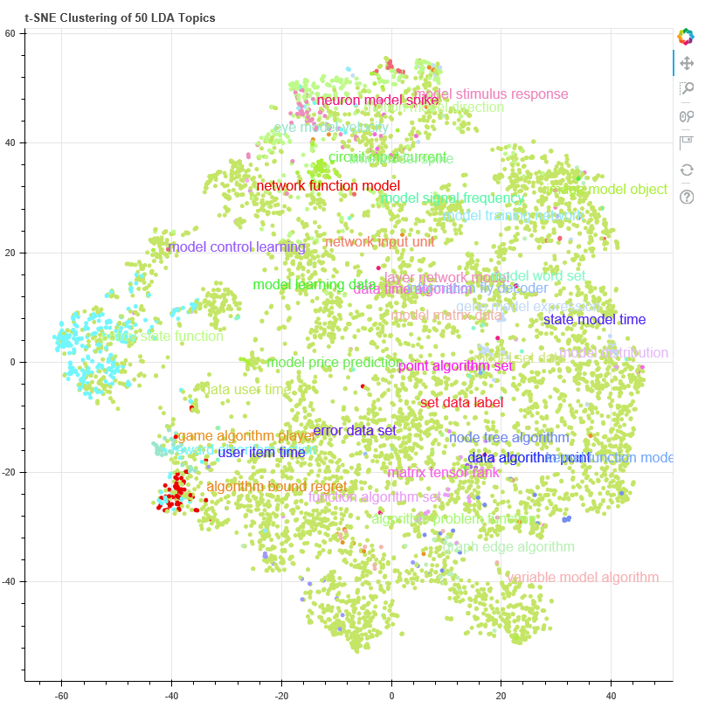
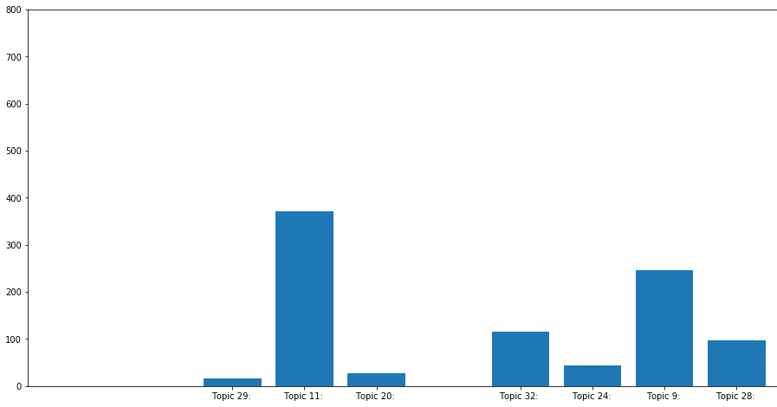

Slide 16
CONCLUSION

